Slide 1
Peer Observations
2015-2016

Slide 2
Definition
Conducted by teachers
Does not count in overall score
Confidential
Comments only
Observe and be observed

Slide 3
Scheduling
Variety of ways- principal makes the ultimate decision
Grade Levels
PLC Groups
Content Areas
Areas of strength/weakness

Slide 4
Pre-Conference
5-15 minutes
Set a time
Set the context of the observation
Determine an area of focus for both teachers- What to look for?
Beneficial- What one teacher wants to see or feedback to provide growth.

Slide 5
Peer Observation
10-15 minutes
Feedback needs to be submitted in i-observation
www.effectiveeducators.com

Slide 6
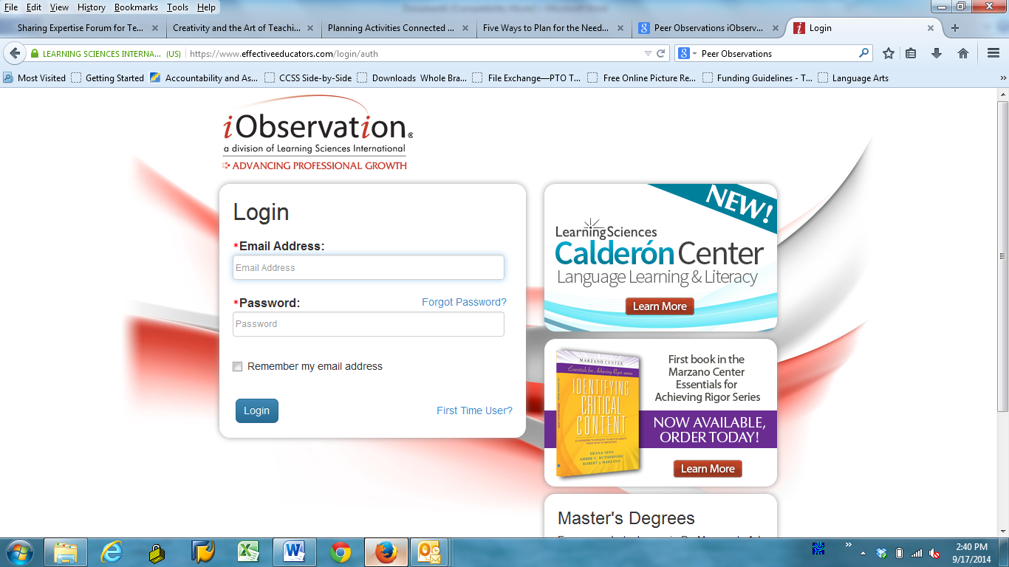
Log into effectiveeducators.com

Slide 7
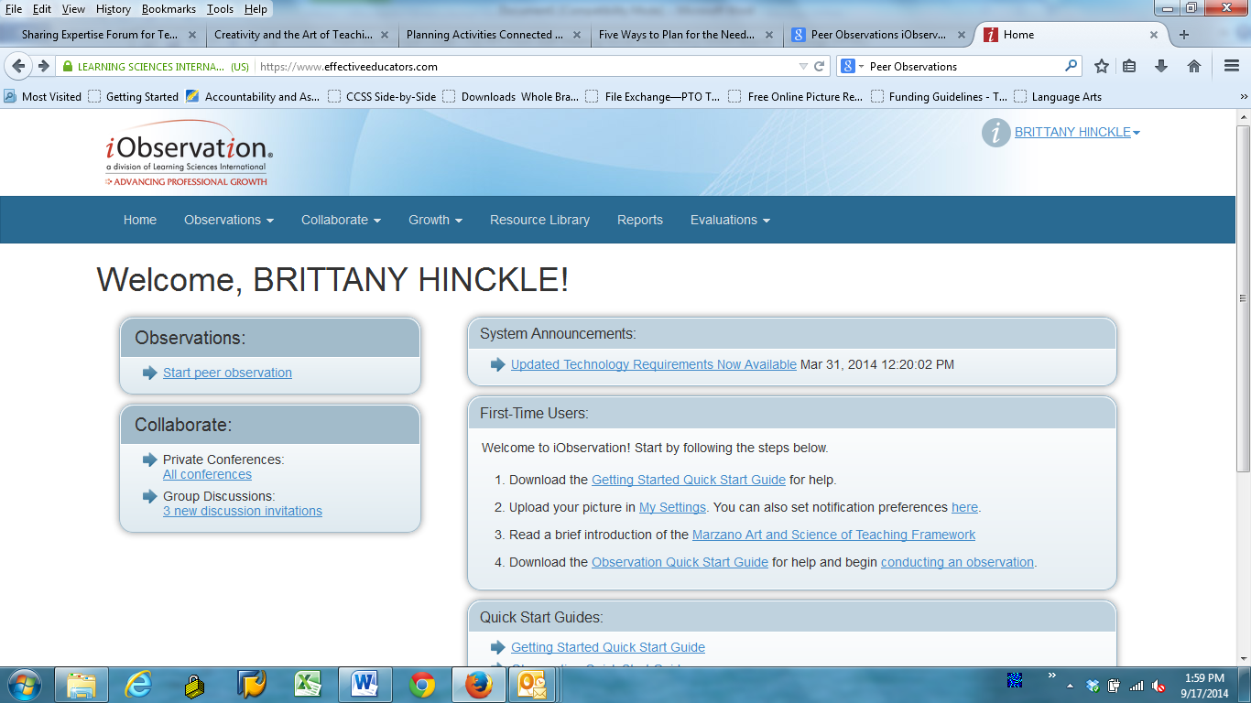
Click on Start peer observation to begin

Slide 8
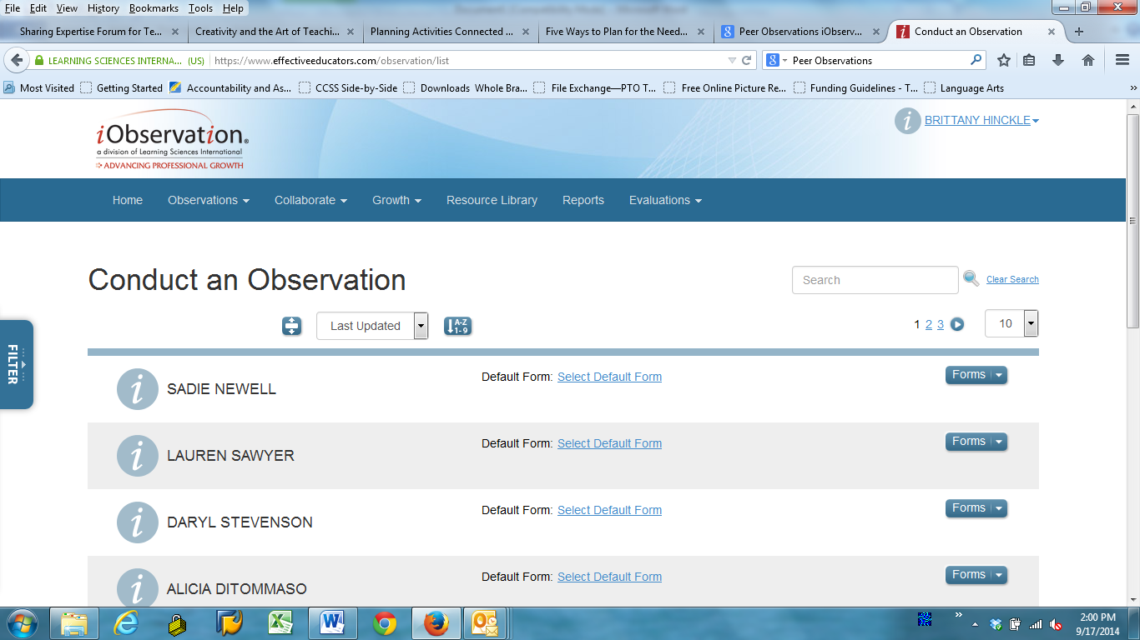
Scroll until you find the teacher you are observing

Slide 9
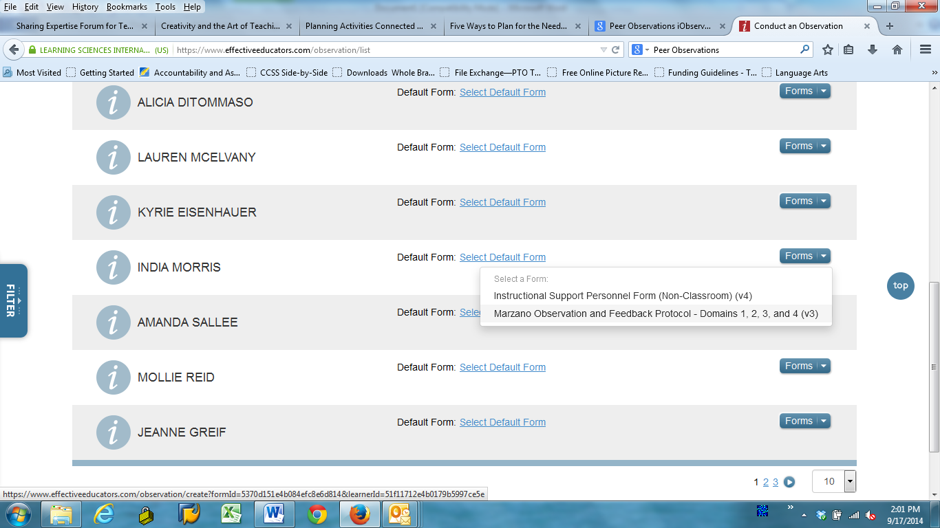
Click on Forms. “Marzano Observation and Feedback Protocol”

Slide 10
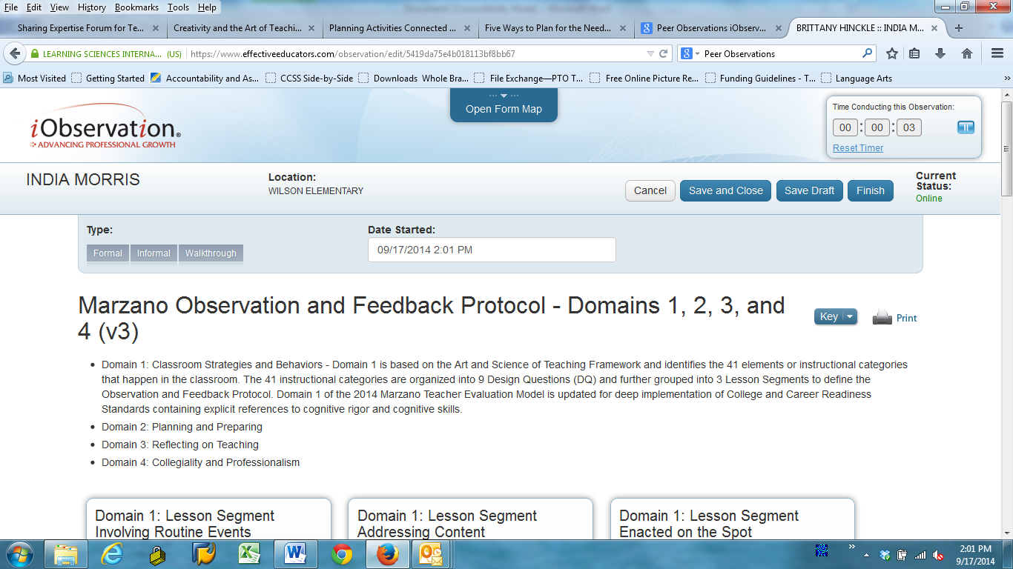
Scroll down

Slide 11
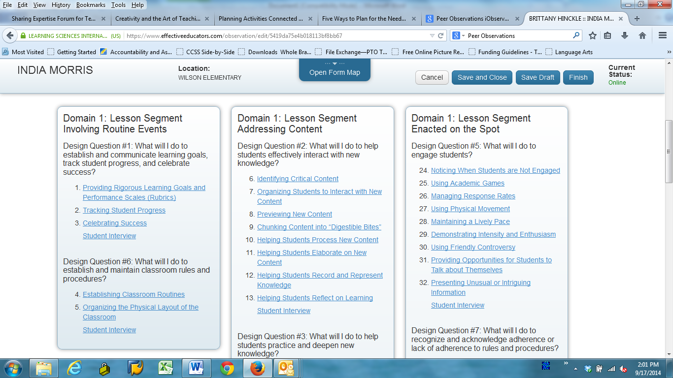
Click on the element you wish to observe

Slide 12
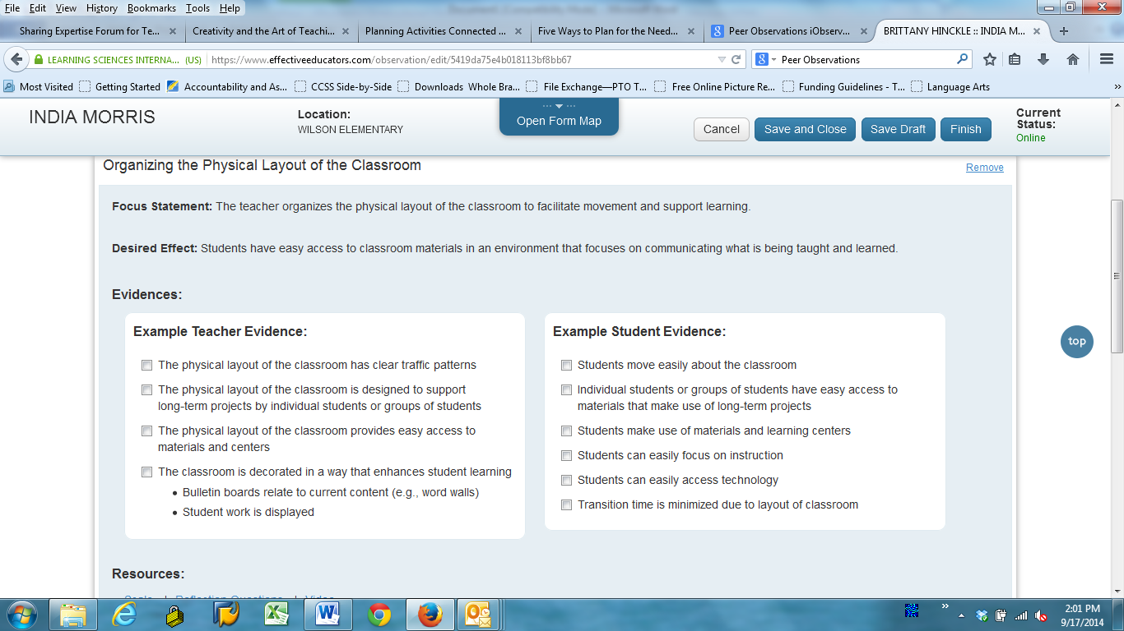
These are SAMPLES, not a checklist.

Slide 13
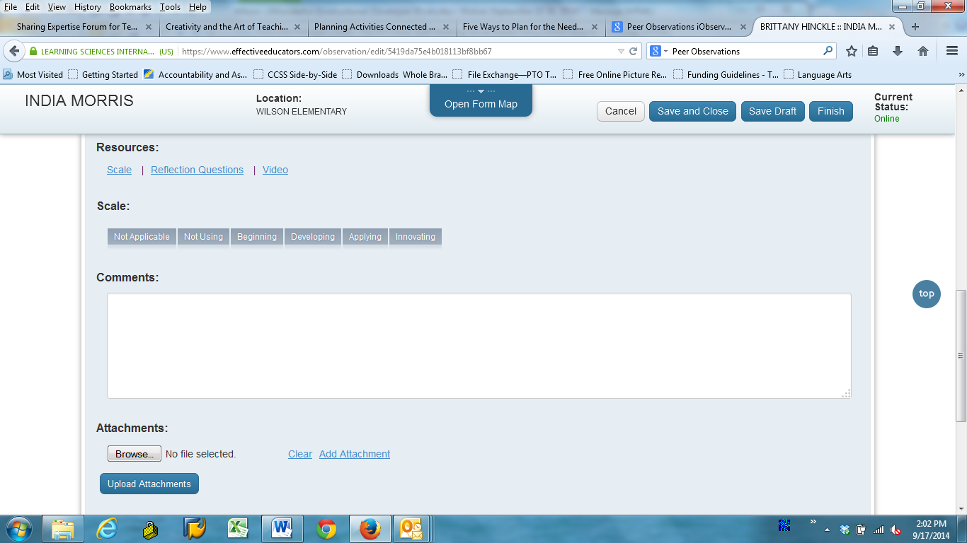
Teachers WILL NOT rate using the scale. Just provide feedback in the comments section.

Slide 14
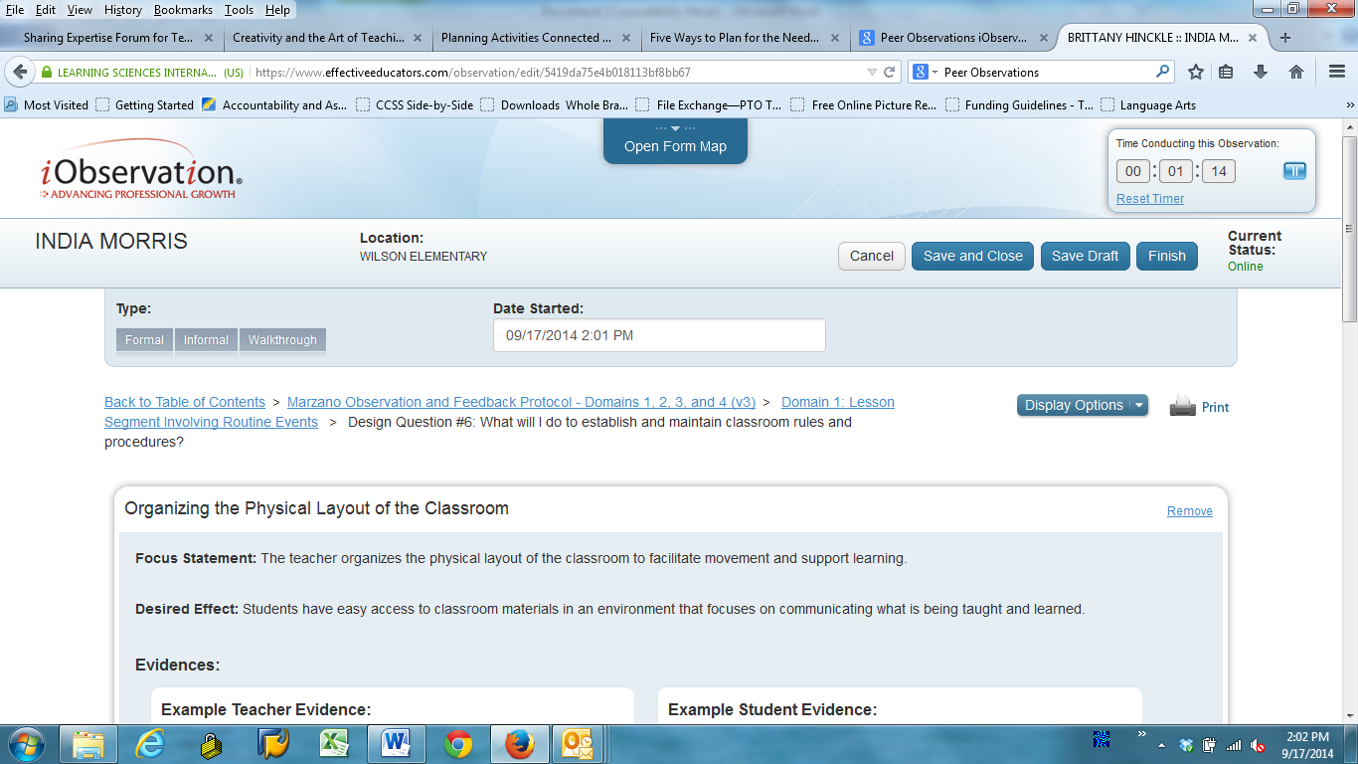
Return to the Table of Contents to score another element

Slide 15
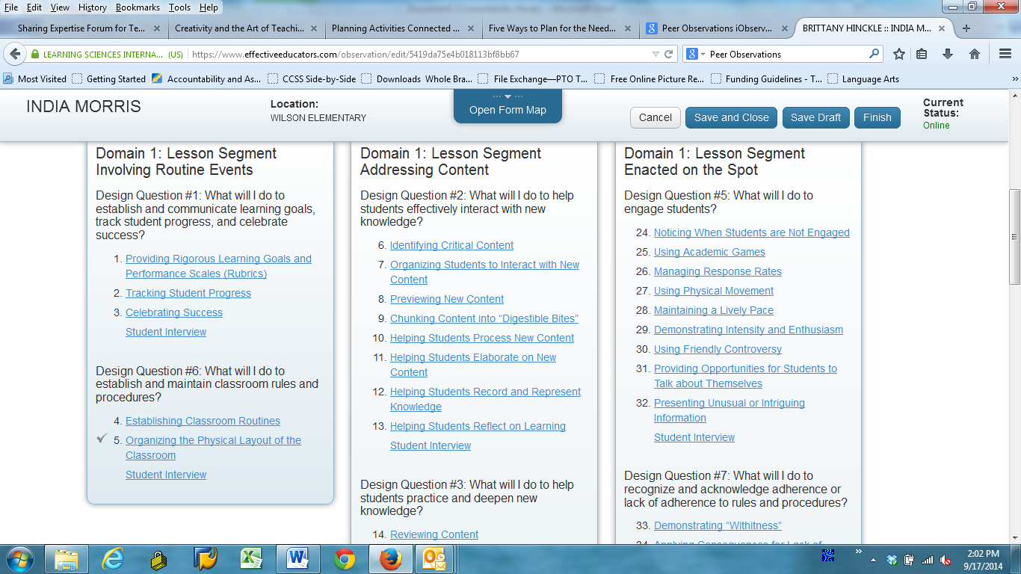
Each element you comment on will have a check mark

Slide 16
When you are finished press one of the 4 options under the timer

Slide 17
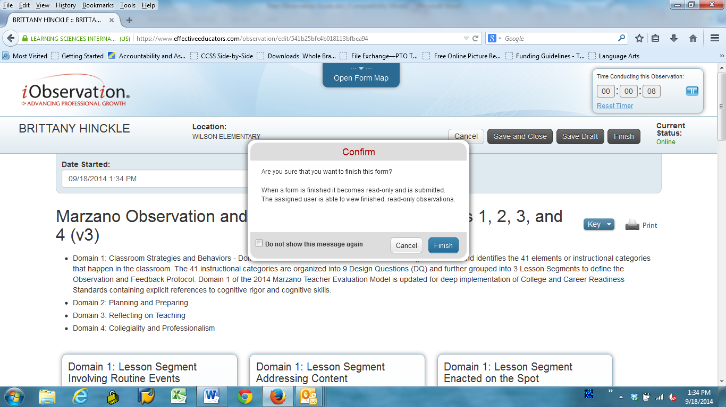
Once you click finish under the timer, the confirm box will appear. Click finish again.

Slide 18
Post-Conference
Teacher will receive feedback in i-observation
Can conduct a post-conference if requested by either party

Slide 19
Questions/Contact
Michelle Lewis malewis@okcps.org

