Slide 1
Completing a leadership observation
Marzano school leadership 2014-2015

Slide 2
Leadership observation domains
For the 2014-2015 school year, Principals and Assistant Principals will be observed using the Marzano School Leadership Model.

Slide 3
Leadership Observations
Number of observations:
2 formal observations that count toward the final evaluation
one before Christmas and one by June
1st observation will occur in buildings and 2nd observation can be in buildings or principals can meet with their supervisor at Central Office

Slide 4
Leadership Observations
What is observed:
13 observable elements for Assistant Principals
14 observable elements for Principals
Maximum of 2 evidences (attachments) per element

Slide 5
Leadership observation domains
Specifically, the focus of the observation will be:
Domain 1
Domain 2- Elements 3-5
Domain 4- Elements 1-3 and Element 5
Domain 5 – Element 1
PRINCIPALS ONLY- Domain 5 Element 5

Slide 8
Leadership Observation Timeline 2014-2015
9/29/2014 - 12/16/2014
4/1/2015 - 6/12/2015
First Round of Leadership Observations
Second Round of
Leadership
Observations
Begin Completing First Leadership Conference Form
Begin Completing Second Leadership Conference Form
9/17/2014
3/2/2015
First Leadership Conference Forms Due
Second Leadership Conference Form Due
10/6/2014
3/27/2015
Today
2014
Sep
Oct
Nov
Dec
Jan 2015
Feb
Mar
Apr
May
Jun
2015

Slide 9
How to complete the Leadership Observation Form

Slide 10
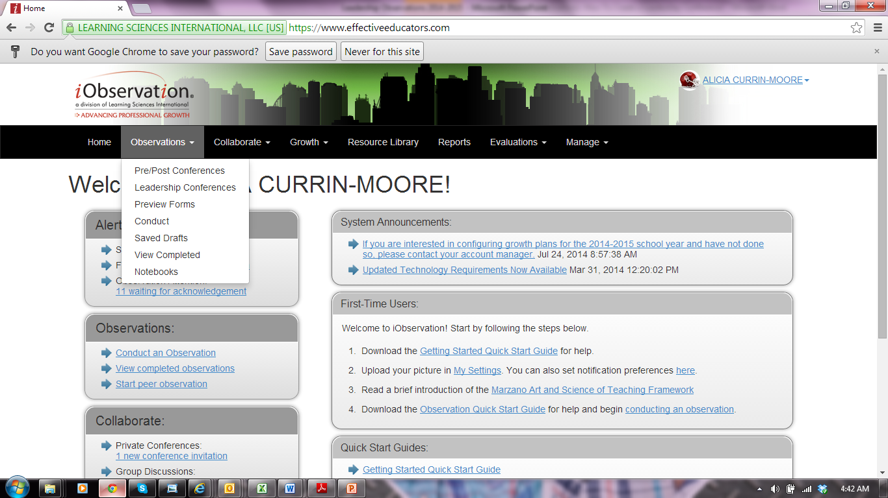
STEP 1- Hover over “Observations” then click “Leadership Conferences”

Slide 11
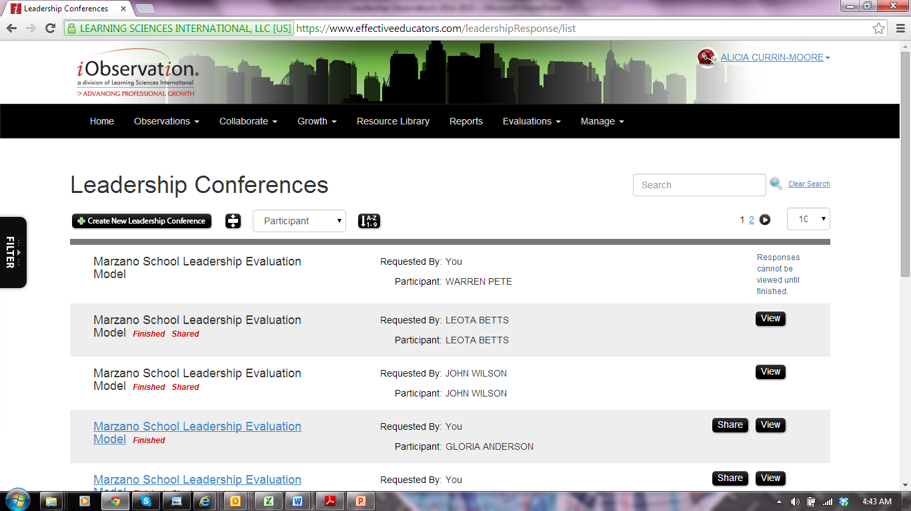
STEP 2- Click “Create New Leadership Conference”

Slide 12
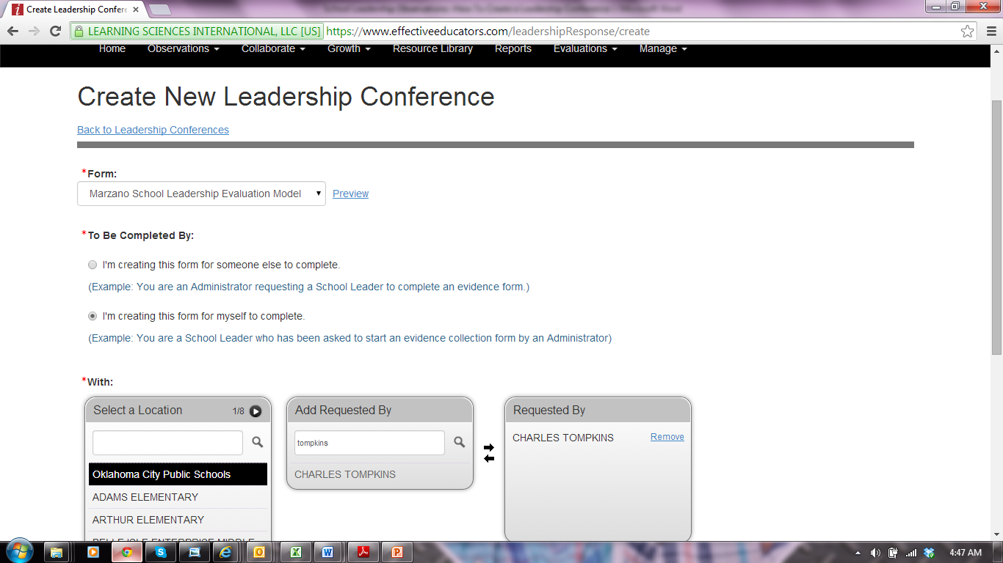
STEP 3a- Under “To Be Completed By” select “I’m creating this form for myself to complete”.

Slide 13
STEP 3b- Under “Add Requested By” search for your immediate supervisor’s name, then click “add”. Click “Next” at the bottom of the page.

Slide 14
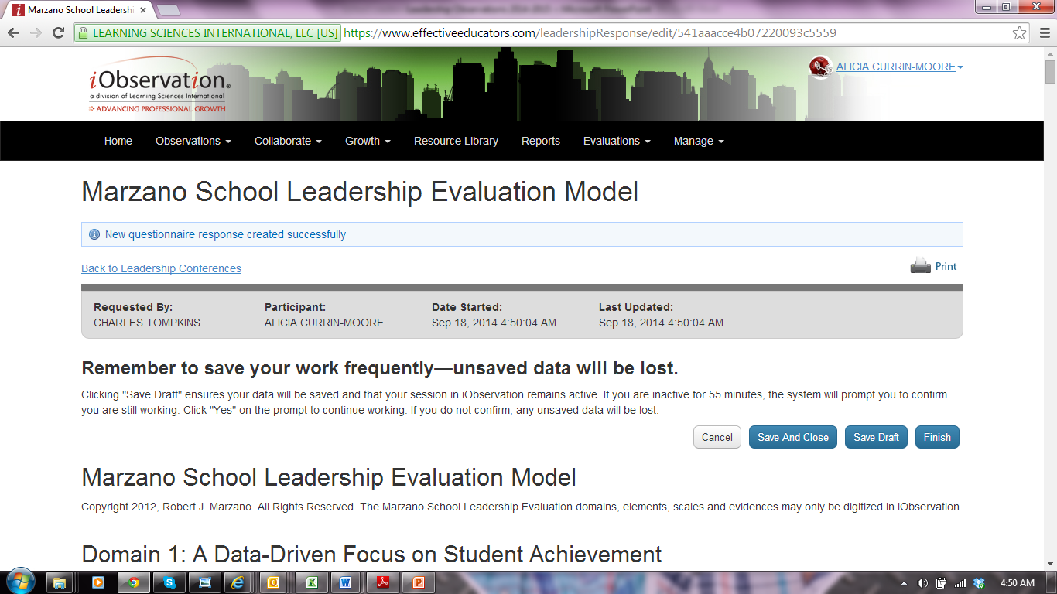
STEP-4 The form should look like this:

Slide 15
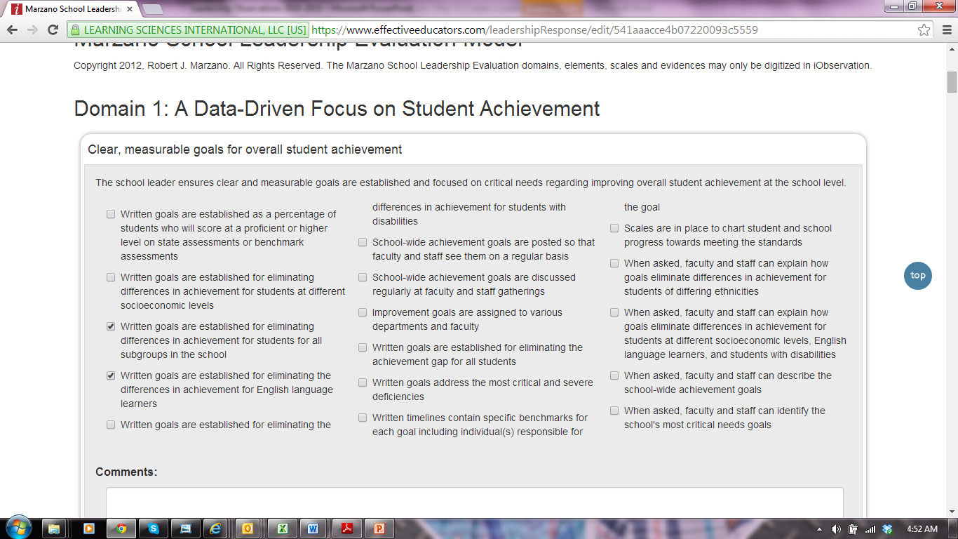
STEP 5- Read the first element in Domain 1. Check the boxes next to the evidence(s) that occur in your building.

Slide 16
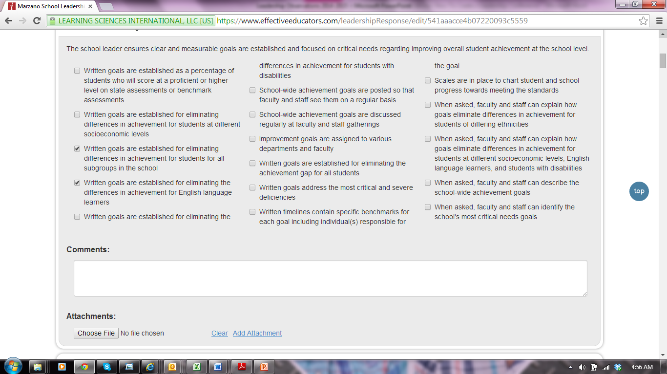
Step 6- Upload documents (maximum of 2) for each element
Notes:
Use the “Marzano Leadership Model with Marzano and OKCPS Evidences” to find specific options for you to upload.

Slide 17
To Upload- Click “Choose file”. You will see all documents that are saved on your computer. Find the document that you would like to upload and click on it then click “open”. The title of the attachment should appear in the box. To include more attachments, click “add attachments”.

Slide 18
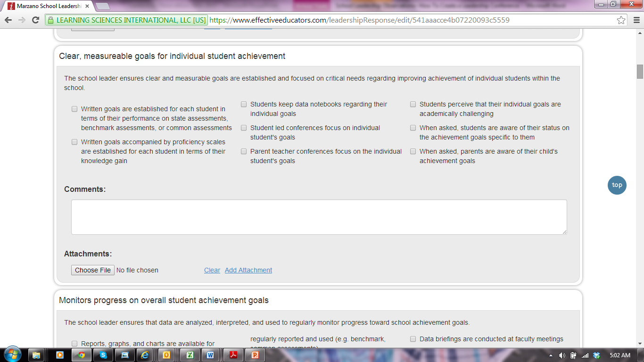
Step 7- Complete Steps 5 and 6 for each required domain/element

Slide 19
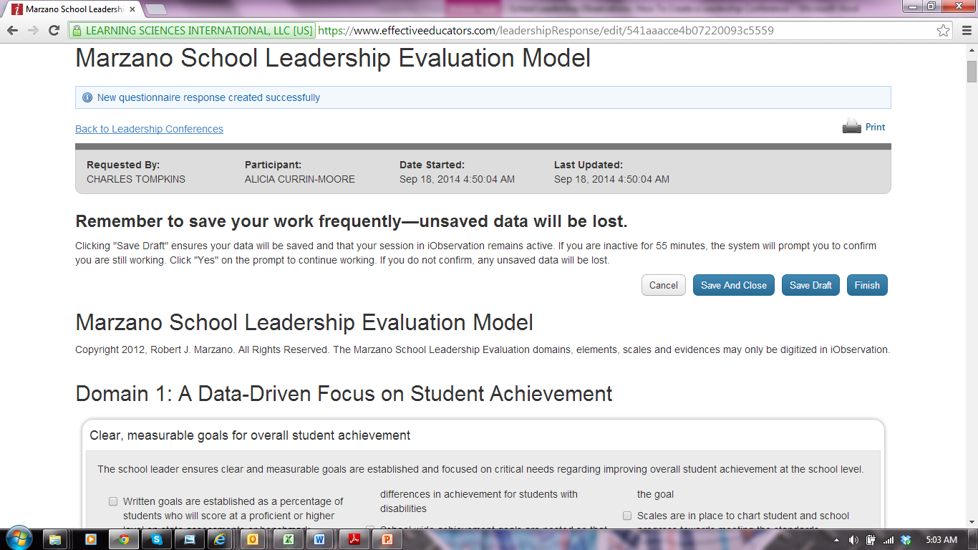
Step 8-click “Finish”
Notes:
Once you click “Finish”, your conference will be automatically sent to your supervisor.

Slide 20
The TLE
Team
X

Slide 21
Contact Information
http://okcpstle.weebly.com/
Alicia Currin-Moore
Director- Aqcurrin-moore@okcps.org
Cyndy Heckman
TLE Coordinator- clheckman@okcps.org
Michelle Lewis
TLE Coordinator- Malewis@okcps.org
LaTasha Timberlake
TLE Coordinator- lstimberlake@okcps.org

